Slide 1
READ ME This template uses the font ‘Space Grotesk’ – be sure to download the font before making edits to the deck. Here’s the link to the ZIP file containing the font. If you cannot access the link above, you can download the font for free via Google Fonts.

Slide 2
Getting Started with .NET MAUI Matthew Leibowitz – .NET MAUI Engineer at Microsoft @mattleibow

Slide 3

.NET Multi-platform App UI (MAUI)
Single project system, single codebase
macOS
iOS
WinUI
Mac Catalyst
iOS
Android

Slide 4

dot.net/maui

Slide 5





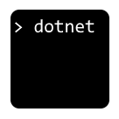
Visual Studio
Visual Studio Code
Visual Studio for Mac
OmniSharp
JetBrains Rider
.NET CLI
dotnet.microsoft.com/platform/tools

Slide 6
Visual Studio 2022 productivity
Intelligent code editing
AI-assisted development
Live Share remote collaboration
C#, XAML, Razor IntelliSense
Rapid iteration
Hot reload XAML, C#, Razor, CSS, and more
Preview and Inspect UI at debug time
Develop for anything, anywhere
Use Android emulators & devices
Develop iOS directly from Windows
Use iOS simulators via Xcode

Slide 7
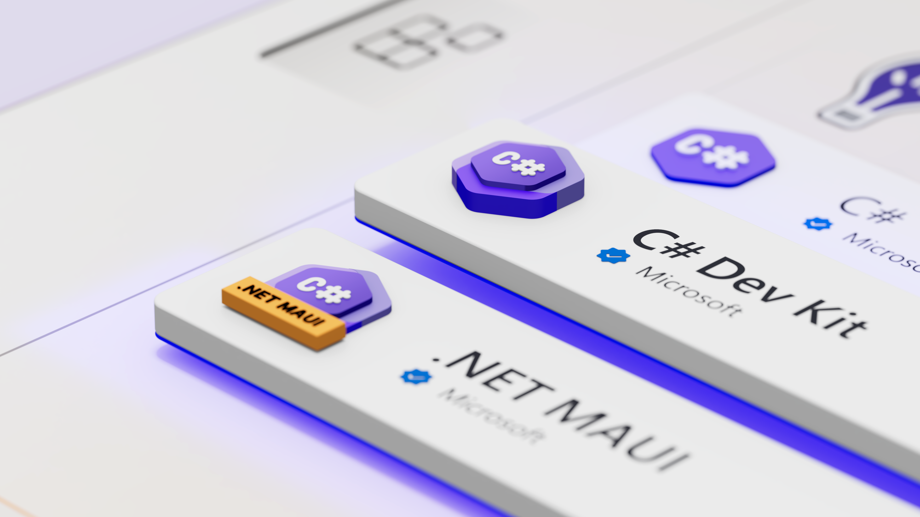
aka.ms/csdevkit
aka.ms/mauidevkit

Slide 8
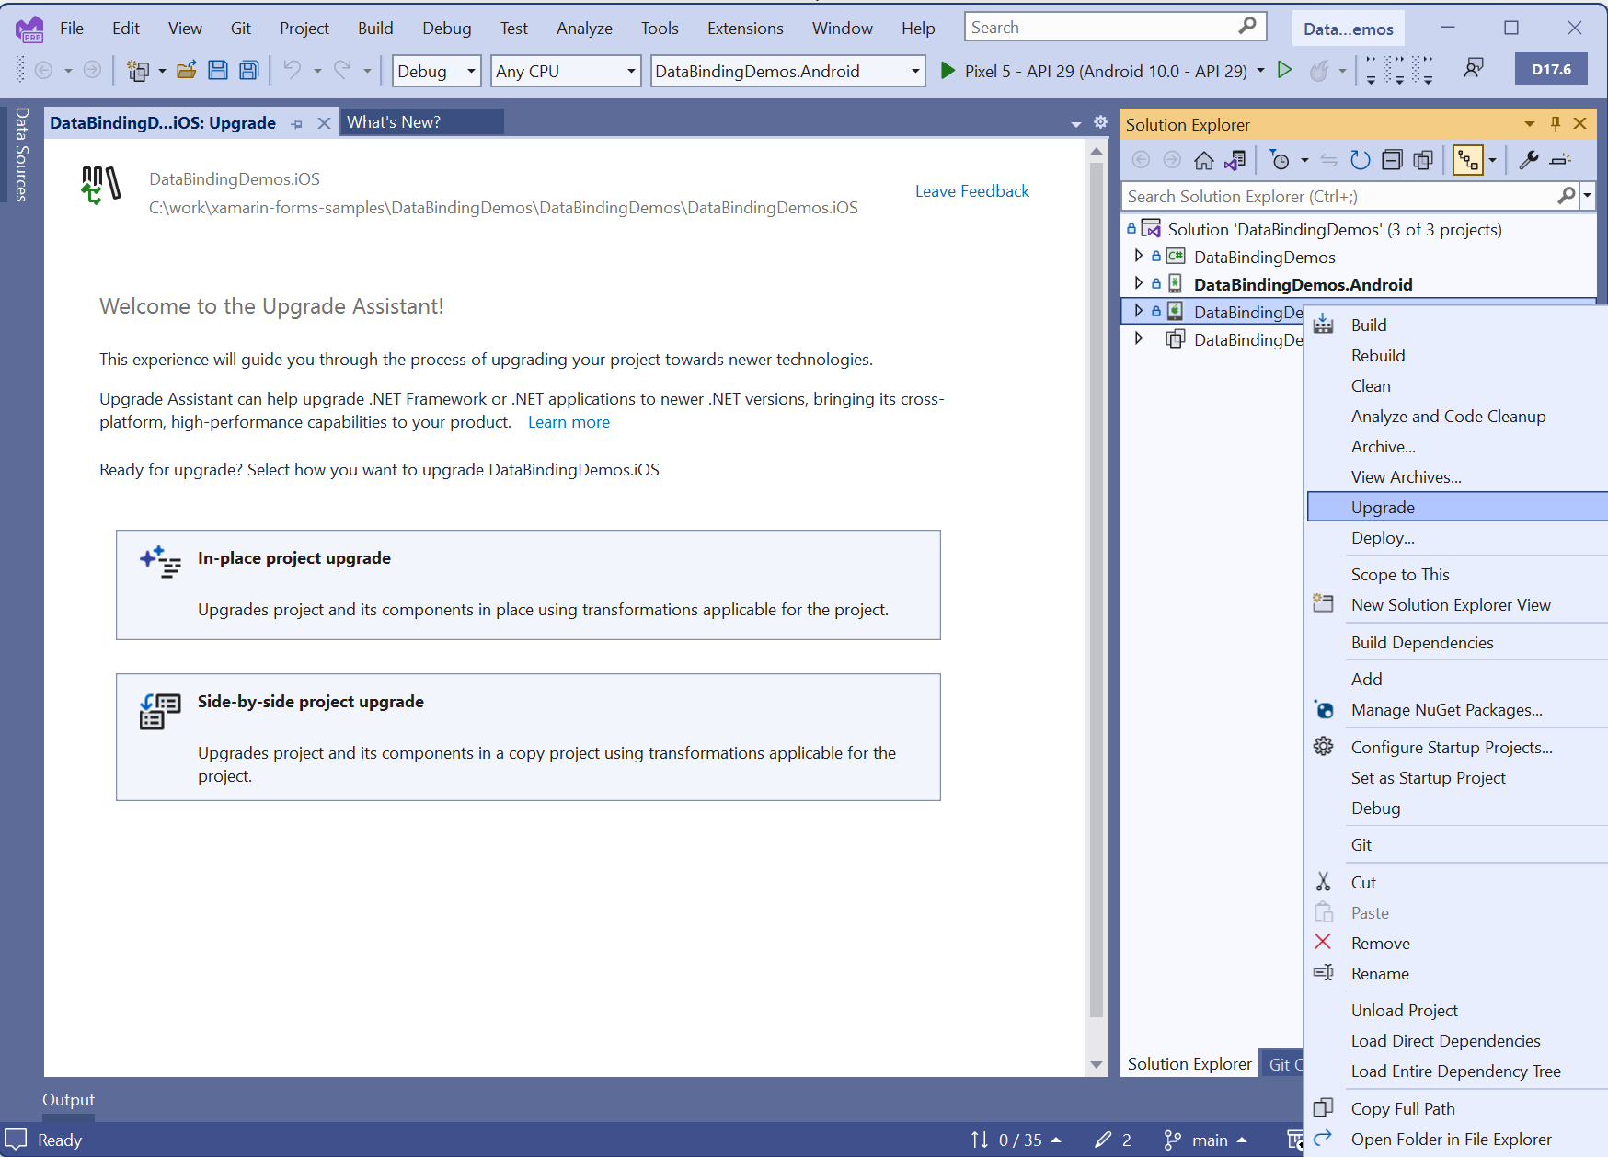
.NET Upgrade Assistant for Xamarin Projects
Highlights:
Converts projects
Replaces known NuGet packages
Fixes namespaces
Fixes base types
Applies various code updates
Also upgrades from .NET 6/7 to .NET 8!
maui-upgrades@microsoft.com
dotnet.microsoft.com/platform/upgrade-assistant

Slide 9
learn.microsoft.com
Documentation aka.ms/maui-docs
First app tutorial aka.ms/maui-tutorial
Learning path aka.ms/maui-learning-path
Samples aka.ms/maui-samples

Slide 10
Your first project
Demo

Slide 11












Thank you to our SPONSORS
Gold Sponsors
Silver Sponsors
Swag Sponsors

Slide 12
Thank you!
dot.net/maui

